Slide 1

Knowing Yourself
Personality Tests Explained

Slide 2
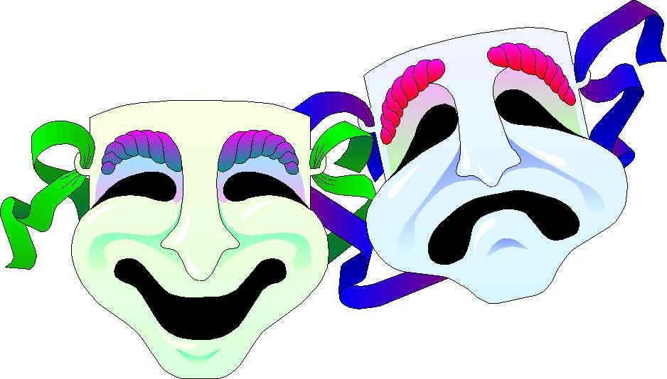

Personality
Originates from the Latin
persona, which means mask.
In ancient Latin theatres, a mask was used to represent a character.

Slide 3

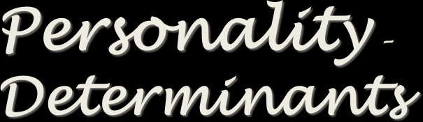

Personality –
Determinants
Heredity
Environment
Situation
Personality:
“Individual differences in characteristic patterns of thinking,feeling, and behaving” (APA, 2017).

Slide 4
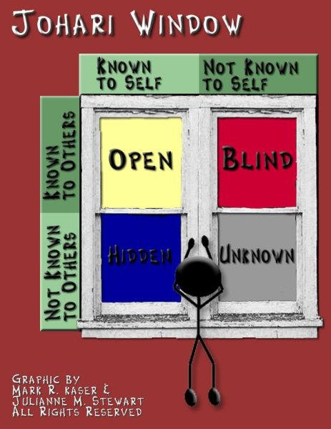
Developed by Joseph Luft and Harry Ingham in 1955.

Slide 5
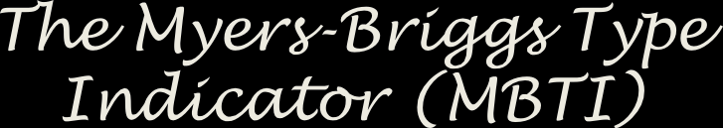
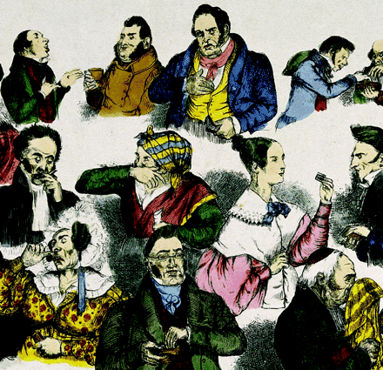

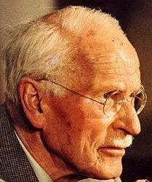
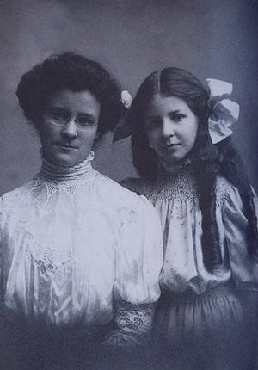
The Myers-Briggs Type
Indicator (MBTI)
What is MBTI?
A personality type diagnostic instrument based on the work of Carl Jung
Developed by Katherine Briggs and
Isabel Myers

Slide 6
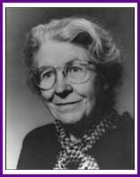
MBTI – Four Personality Dimensions
Social Orientation
Extravert (E) vs. Introvert (I)
Information Gathering
Sensing (S) vs. Intuitive (N)
Information Evaluation
Thinking (T) vs. Feeling (F)
Reasoning Approach
Judging (J) vs. Perceiving (P)
“Whatever the circumstances of your life, the understanding of type can make your perceptions clearer, your judgments sounder, and your life closer to your heart’s desire.”
Isabel Briggs Myers (1962) (Co-developer of MBTI with Katherine Briggs)

Slide 7
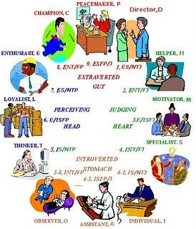
MBTI
Questionnaire
EXTROVERSION | INTROVERSION
Outgoing Publicly impressive Interacting Speaks, then thinks Gregarious | Quiet Reserved Concentrating Thinks, then speaks Reflective
SENSING | INTUITING
Practical Specific Feet on the ground Details Concrete | General Abstract Head in the clouds Possibilities Theoretical
THINKING | FEELING
Analytical Clarity Head Justice Rules | Subjective Harmony Heart Mercy Circumstances
JUDGING | PERCEIVING
Structured Time oriented Decisive Makes lists / uses them Organised | Flexible Open ended Exploring Makes lists / loses them Spontaneous
Assessing my MBTI Profile
Type Preferences and Descriptors

Slide 8




Emotional Stability
Agreeableness
The Big Five Personality
Model
Five-Factor Model of Personality
A more recent way to describe personalities
Conscientiousness
Extraversion
Goldberg (1993)

Slide 9
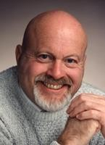
Core Traits | Descriptive Characteristics of High Scores
Conscientiousness | Dependable, hardworking, organized, self disciplined, persistent, responsible
Emotional Stability | Calm, secure, happy, unworried
Agreeableness | Cooperative, warm, caring, good-natured, courteous, trusting
Extroversion | Sociable, outgoing, talkative, assertive, gregarious
Openness to experience | Curious, intellectual, creative, cultured, artistic, sensitive, flexible, imaginative
Developing the Big Five Model
Lewis R. Goldberg (1993) consolidated ongoing research in reducing the number of personality traits
Multiple Acronyms
OCEAN CANOE
CEAEO
My Preference
Five-Factor Model of Personality
Source: Goldberg, (1993)

Slide 10

Personality
Type A Vs.
Type B

Slide 11



Type A vs. type B
Type A Personality:
Aggressive involvement in a chronic, incessant, struggle to achieve more and more in less and less time and, if necessary, against the opposing efforts of other things or other people.
Type A Personality
Behavioral Indicators:
Are always moving, walking and eating Rapidly
Feel impatient with the rate at which most events take place
Strive to think or do two or more things at once
Cannot cope with leisure time
Are obsessed with numbers, measuring their success in terms of how many or how much of everything they acquire

Slide 12

Type B Personality
Behavioral Indicators:
Never suffer from a sense of time urgency with its accompanying impatience
Feel no need to display or discuss their achievements or accomplishments unless such exposure is demanded by the situation.
Play for fun and relaxation, rather than to exhibit their superiority at any cost
Can relax without guilt.
Type B Personality:
Rarely hurried by the desire to obtain a wildly increasing number of things or participate in an endless growing series of events in an ever- increasing amount of time.

Slide 13
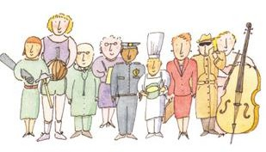
Do What You Are!

